Slide 1

Iterative Structures
Prepared and presented by - Naomi Padmore

Slide 2
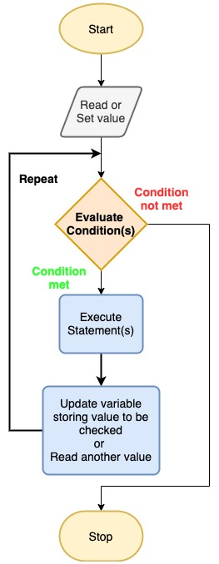
Iterative Structures
Allows us to repeat a sequence of code multiple times
Notes:
It allows us to make more complex programs; able to have multiple paths of execution

Slide 3
Cases
Three Times Tables program
Averaging a Sum of Numbers program
Guess the Number program

Slide 4
Case 1
Three times Tables Program

Slide 5
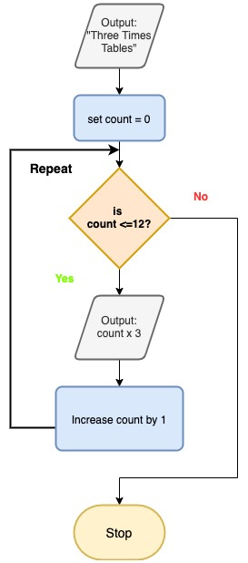
Case 1
Three Times Table

Slide 6
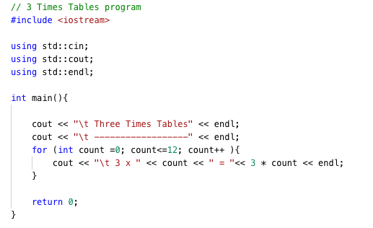
For Loop
for (initialization ; condition ; increment) {
statement1;
statement2;
}

Slide 7
Case 2
Averaging a Sum of Numbers Program

Slide 8
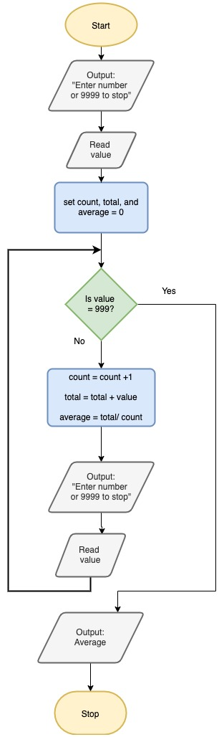
Case 2
Averaging Program

Slide 9
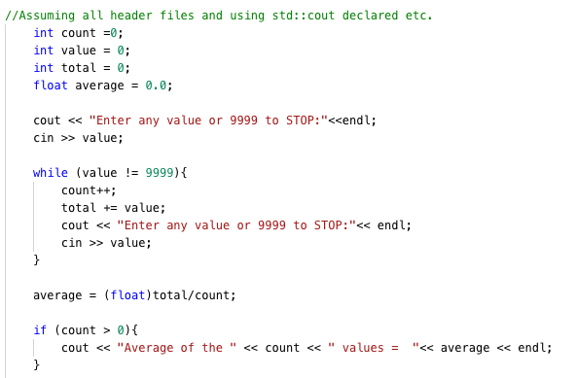
While Loop
while (condition) {
statement1;
statement2;
}

Slide 10
Case 3
Guess The Number Program

Slide 11
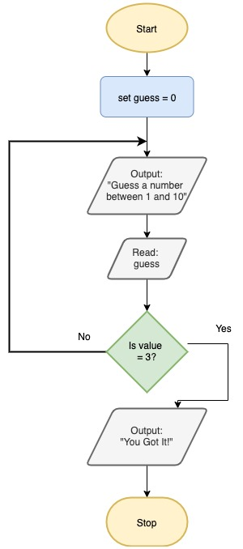
Case 3
Guessing a number between 1 and 10

Slide 12
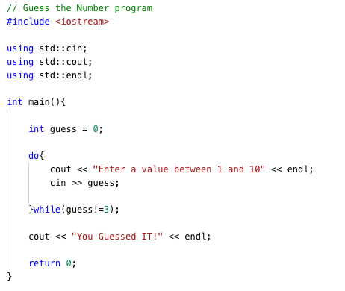
Do… while Loop
do {
statement1;
statement2;
} while (condition);

Slide 13
That’s All

